Slide 1
6.3: Double and Half-Angle Identities
MATH 1550 - Precalculus

Slide 2
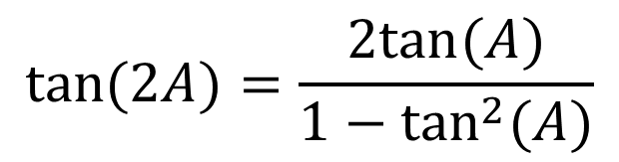
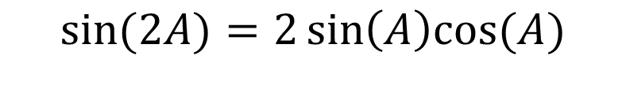
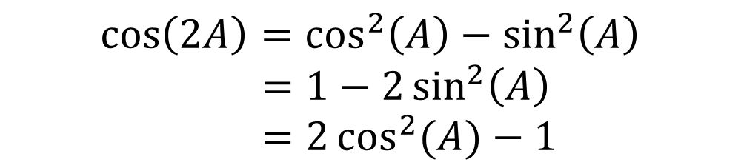
Double-Angle Identities
$$\sin{(2A)}=2\sin\left(A\right)cos⁡(A)$$
$$\tan{(2A)}=\frac{2tan⁡(A)}{1−\tan^{2}{(A)}}$$
$$\cos\left(2A\right)=\cos^{2}\left(A\right)−\sin^{2}\left(A\right) \\ =1−2\sin^{2}\left(A\right) \\ =2\cos^{2}{(A)}−1$$

Slide 3
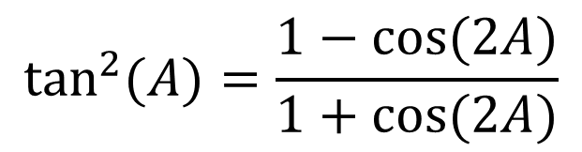
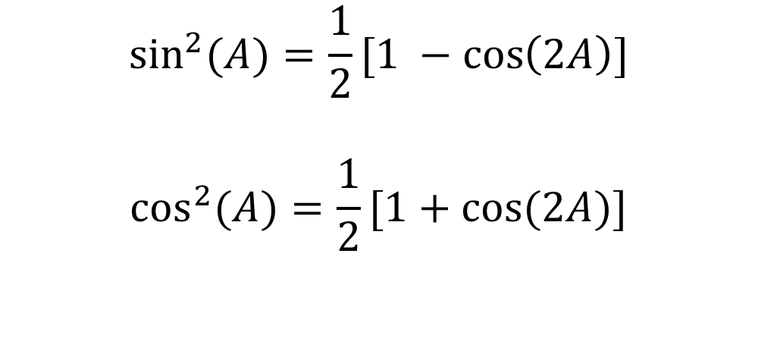
Power Reducing Formulas
$$\sin^{2}{(A)}=\frac{1}{2}[1 −\cos\left(2A\right)]$$
$$\cos^{2}{(A)}=\frac{1}{2}[1+cos⁡(2A)]$$
$$\tan^{2}{(A)}=\frac{1−cos⁡(2A)}{1+\cos{(2A)}}$$

Slide 4
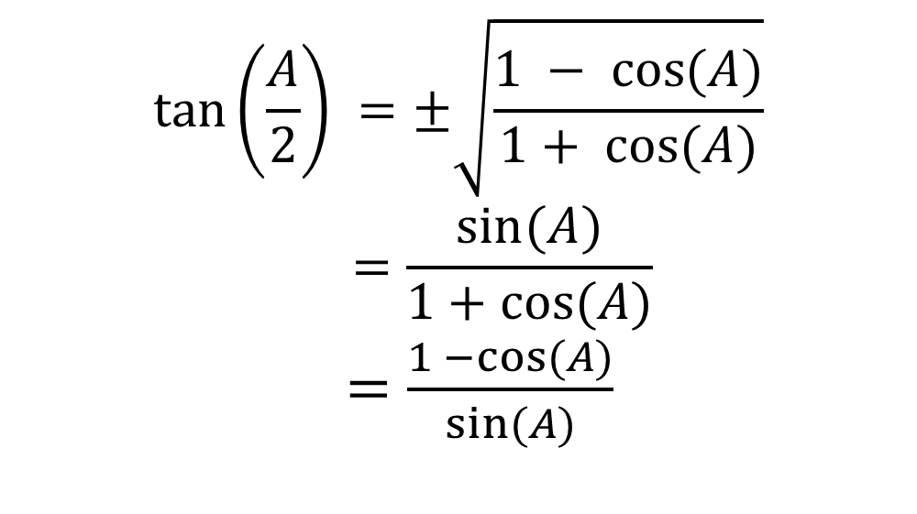

Half-Angle Identities
$$\tan\left(\frac{A}{2}\right) =±\sqrt{\frac{1 −\cos{(A)}}{1+ cos⁡(A)}} \\ =\frac{sin⁡(A)}{1+cos⁡(A)}$$
$=\frac{1 −cos⁡(A)}{sin⁡(A)}$
$$\sin\left(\frac{A}{2}\right)= ±\sqrt{\frac{1 −\cos{(A)}}{2}}$$
$$\cos\left(\frac{A}{2}\right)=±\sqrt{\frac{1 +\cos{(A)}}{2}}$$

